Slide 1
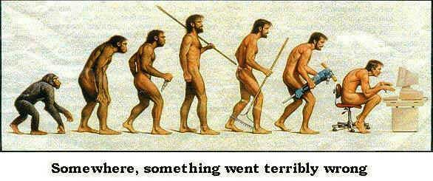
TECHNOLOGY & BUSINESS

Slide 2
Information Systems
Why Do People Need Information?
Individuals - Entertainment and enlightenment
Businesses - Decision making, problem solving and control

Slide 3
Data & Information
Data
Raw facts such as an employee’s name and number of hours worked in a week, inventory part numbers or sales orders.
A “given,” or fact; a number, a statement, or a picture
Represents something in the real world
Information
A collection of facts organized in such a way that they have additional value beyond the value of the facts themselves.
Data that have meaning within a context
Data in relationships
Data after manipulation

Slide 4
Data, Information, & Systems
What Is a System?
System: A set of components that work together to achieve a common goal
Subsystem: One part of a system where the products of more than one system are combined to reach an ultimate goal
Closed system: Stand-alone system that has no contact with other systems
Open system: System that interfaces with other systems

Slide 5
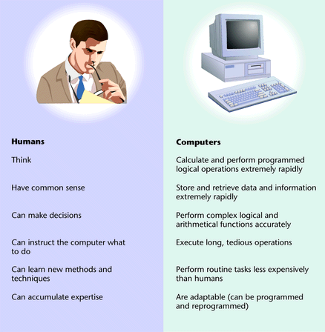
Data, Information, & Systems

Slide 6
The Benefits of Human-Computer Synergy
Synergy
When combined resources produce output that exceeds the sum of the outputs of the same resources employed separately
Allows human thought to be translated into efficient processing of large amounts of data

Slide 7
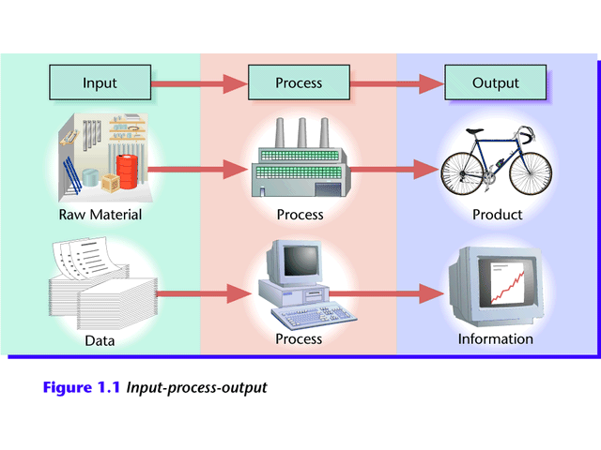
Data, Information, & Systems
Generating Information
Computer-based ISs take data as raw material, process it, and produce information as output.
Input-process-output

Slide 8
Characteristics of Useful Information
Relevant. It reduces uncertainty by helping you predict what will happen or confirm what already has happened.
Reliable. It’s dependable, i.e., free from error or bias and faithfully portrays events and activities.
Complete. It doesn’t leave out anything that’s important.
Current. You get it in time to make your decision.
Understandable. It’s presented in a manner you can comprehend and use.
Verifiable. The nature of the information is such that different people would tend to produce the same result.
Accessible. You can get to it when you need it and in a format you can use.

Slide 9
Information Systems
An information system(IS) is typically considered to be a set of interrelated elements or components that collect(input), manipulate(processes), and disseminate (output) data and information and provide a feedback mechanism to meet an objective.

Slide 10
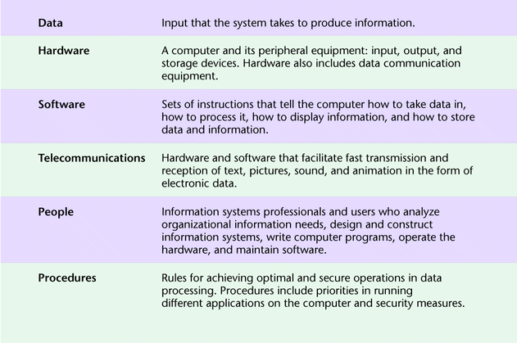
Components of an Information System

Slide 11
Computer-based Information System
An Information System is an organized combination of people, hardware, software, communication networks and the data resources that collects, transforms and disseminates information in a organization.

Slide 12
Management Support Systems (MSS)
MSS provide information and support needed for effective decision making by manager.
The three main types are:
Management Information Systems
Decision Support Systems
Executive Information Systems

Slide 13
Management Information Systems
The study of information technology in business settings
To provide managers with information
To perform regular, routine operations
To help managers control, organize and plan better

Slide 14
MIS in Action
In 2005, Wal-Mart attained more than $285 billion in sales – nearly one-tenth of retail sales in the U.S. – in large part because of its RetailLink System, which digitally links its suppliers to every one of Wal-Mart’s 5, 289 stores worldwide. As soon as a customer purchases an item, the supplier monitoring the item knows to ship a replacement to the shelf.

Slide 15
MIS in Action
Every time a dress shirt is bought at a JCPenny store in the U.S., the record of the sale appears immediately on computers in Hong Kong at its supplier, TAL Apparel Ltd., a large contract manufacturer that produces one in eight dress shirts sold in the U.S. TAL decides how many replacement shirts to make, and in what styles, colors, and sizes, and then sends the shirts to each JCPenny store. JCPenny’s shirt inventory is near zero, as is the cost of storing it.

Slide 16
Info. Glut
When you get more information than you can effectively assimilate, you suffer from information overload.
When you’ve reached the overload point, the quality of decisions declines while the costs of producing the information increases.

Slide 17
IT vs. IS
INFORMATION TECHNOLOGY
Hardware
Software
Databases
Networks
Other related components
are used to build
INFORMATION SYSTEMS
Payroll System
Inventory System
Marketing System
Customer Service System

Slide 18
The Four Stages of Data Processing
Input: Data is collected and entered into computer.
Data processing: Data is manipulated into information using mathematical, statistical, and other tools.
Example: customer survey
Reading through data collected from a customer survey with questions in various categories would be time-consuming and not very helpful.
When manipulated, the surveys may provide useful information.
Output: Information is displayed or presented.
Storage: Data and information are maintained for later use.

Slide 19
Functional Perspectives of MIS
Financial MIS
Will integrate information from multiple sources
Functions
Costing
Auditing
Funds management

Slide 20
Functional Perspectives of MIS
Manufacturing
Design and Engineering
Master Production Scheduling
Inventory Control
Materials Planning
Manufacturing and Process Control
Quality Control

Slide 21
Functional Perspectives of MIS
Marketing
Market research
Web-based market research
Pricing

Slide 22
Functional Perspectives of MIS
Transportation and Logistics
Route and schedule optimization
Human Resources
Accounting

Slide 23
Functional Perspectives of MIS
Executive Information Systems
High level with drill down
Key business and industry data
Structured and unstructured information
Structured: MTD orders
Unstructured: Industry newsfeed
Graphical

Slide 24
Ethical and Societal Issues
Consumer Privacy
Organizations collect (and sometimes sell) huge amounts of data on individuals.
Employee Privacy
IT supports remote monitoring of employees, violating privacy and creating stress.
Freedom of Speech
IT increases opportunities for pornography, hate speech, intellectual property crime, an d other intrusions; prevention may abridge free speech.

Slide 25
Ethical and Societal Issues
IT Professionalism
No mandatory or enforced code of ethics for IT professionals--unlike other professions.
Social Inequality
Less than 20% of the world’s population have ever used a PC; less than 3% have Internet access.

Slide 26
The Wireless Revolution
Mobile phones have become mobile platforms for delivering digital data, used for recording and downloading photos, video and music, Internet access, and transmitting payments.
An array of technologies provides high-speed wireless access to the Internet for PCs and other wireless handheld devices and cell phones.
Businesses increasingly use wireless to cut costs, increase flexibility, and create new products and services.

Slide 27
The Wireless Revolution
Wireless communication helps businesses easily stay in touch with customers, suppliers, and employees.
Wireless networking increases worker productivity and output, as workers take less time to establish contact with people and to access information. Companies can save on wiring offices, moving, and making network changes by using wireless networks.
Wireless technology has also been the source of new products, services, and sales channels in a variety of industries, e.g. OnStar, Starbucks “hot spots”.

Slide 28
Two Technologies for Agility
Virtualization:
The ability to run multiple operating systems on a single physical system and share the underlying hardware resources
(VMware white paper, Virtualization Overview)
Cloud Computing:
“The provisioning of services in a timely (near on instant), on-demand manner, to allow the scaling up and down of resources”
(Alan Williamson, quoted in Cloud BootCamp March 2009)

Slide 29
How Cloud Computing Works
Various providers let you create virtual servers
Set up an account, perhaps just with a credit card
You create virtual servers ("virtualization")
Choose the OS and software each "instance" will have
It will run on a large server farm located somewhere
You can instantiate more on a few minutes' notice
You can shut down instances in a minute or so
They send you a bill for what you use

Slide 30
Cloud Computing Status
Seems to be rapidly becoming a mainstream practice
Numerous providers
Amazon EC2 imitators ...
Just about every major industry name
IBM, Sun, Microsoft, ...
Major buzz at industry meetings

Slide 31
What is Computer Security?
General definition: computer security involves providing appropriate levels of assurance of
Availability of computing services and data/information stored in computing systems
Confidentiality of data/information stored in computing systems
Integrity of computing systems and data/information stored therein
Auditability of usage of computing systems and access to data/information stored therein
Non-repudiability of transactions initiated by individuals and organizations

Slide 32
Not Just An IT Problem
Everyone who uses a computer needs to understand how to keep his or her computer and data secure.
10% of security safeguards are technical
90% of security safeguards rely on us – the user - to adhere to good computing practices

Slide 33
Devices include:
Desktop computers Confidential data
Laptop computers Restricted data
Servers Personal information
Blackberries Archives
Flash drives Databases

Slide 34
Major Solutions
Authentication--proving the identity of a person or system
Access control--limiting who and what can gain access to
Systems and their components
Network devices
Applications
Data
Encryption-- transforming data in a manner such that they cannot be meaningfully read because they are garbled
Auditing and monitoring

Slide 35
ALSO . . .
See the following online:
Evolution of the PC
http://www.aarp.org/home-family/personal-technology/info-10-2012/evolution-of-the-pc.html#slide1
Kids react to Old Computers
http://www.youtube.com/watch?v=PF7EpEnglgk

